Slide 1

Data Cleaning, Analysis and Visualization

Slide 2
OBJECTIVES OF PROJECT :
Data Collection
Data Cleaning
Data Analysis
Data Visualization using Power BI
Conclusion

Slide 3
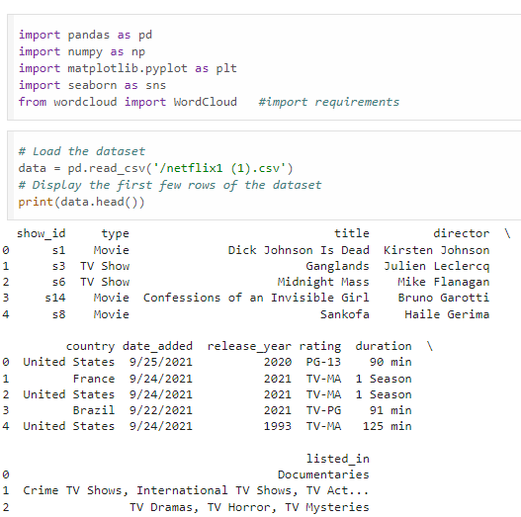
Data Collection:-

Slide 4
PROBLEM SOLVING:
Data Cleaning
1. Treat the Nulls
2. Treat the duplicates
3. Populate missing rows
4. Drop unneeded columns
5. Split columns

Slide 5
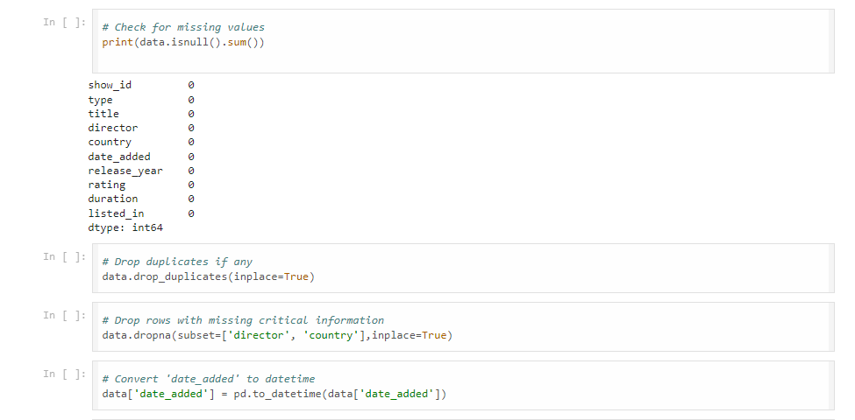

Slide 6
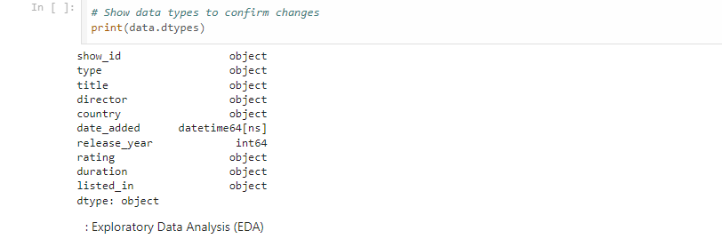
Datatype changes:

Slide 7
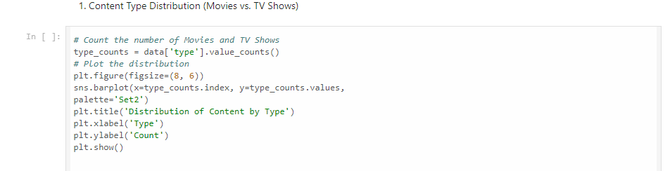
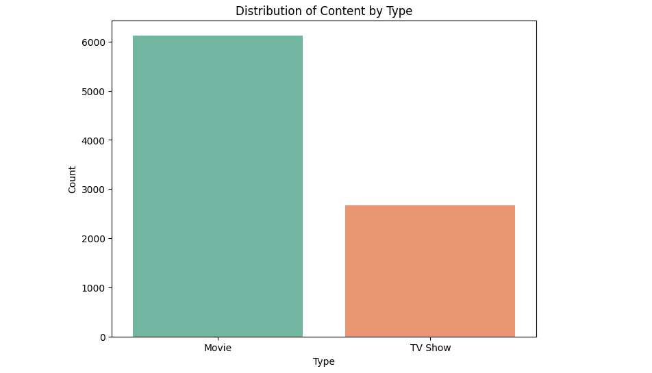
Data Vizualisation:-

Slide 8
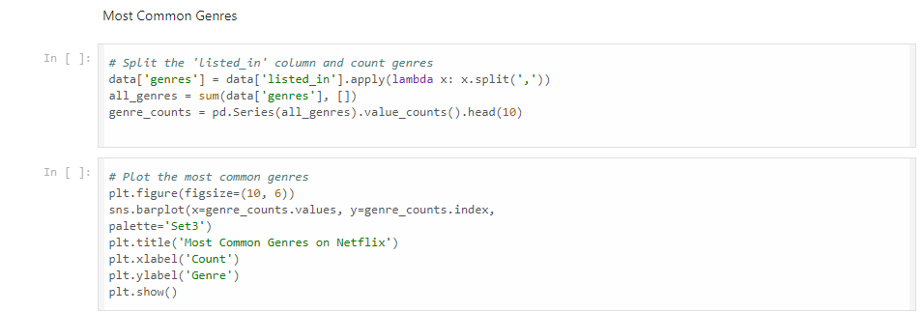
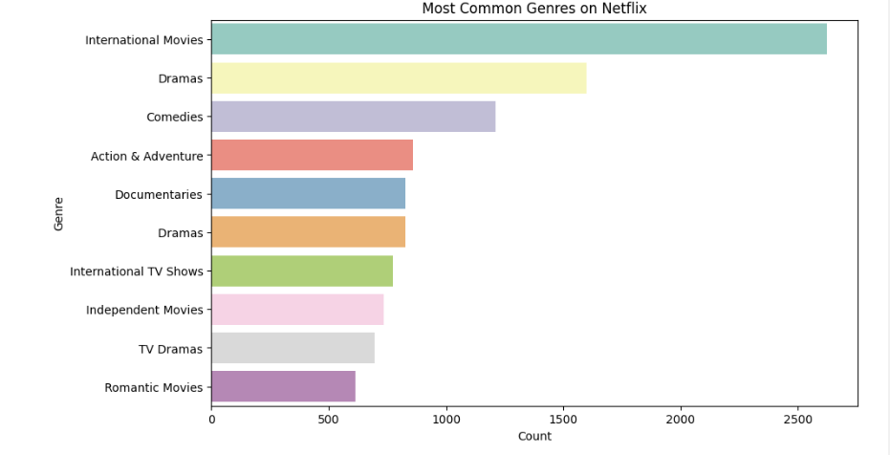

Slide 9
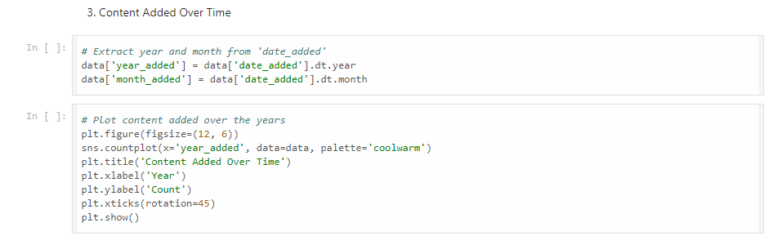
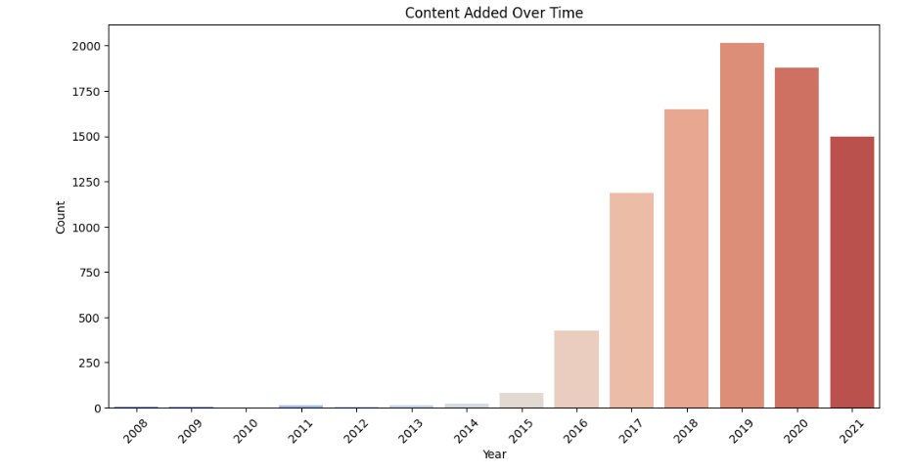

Slide 10
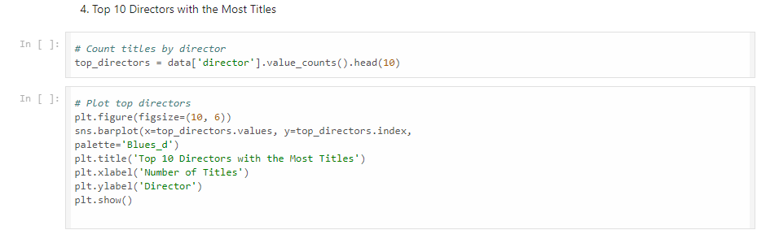
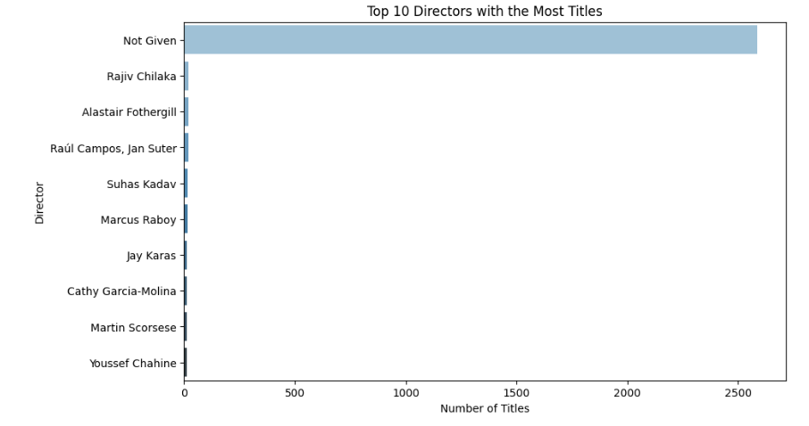

Slide 11
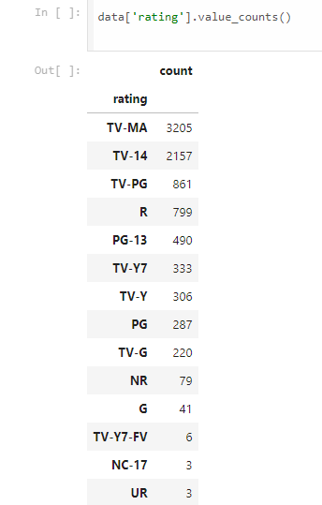
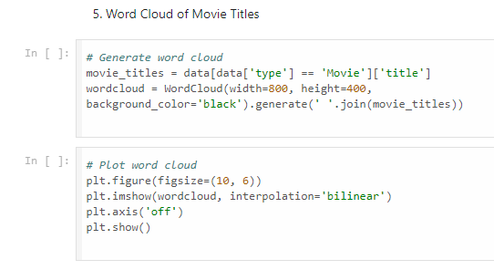

Slide 12
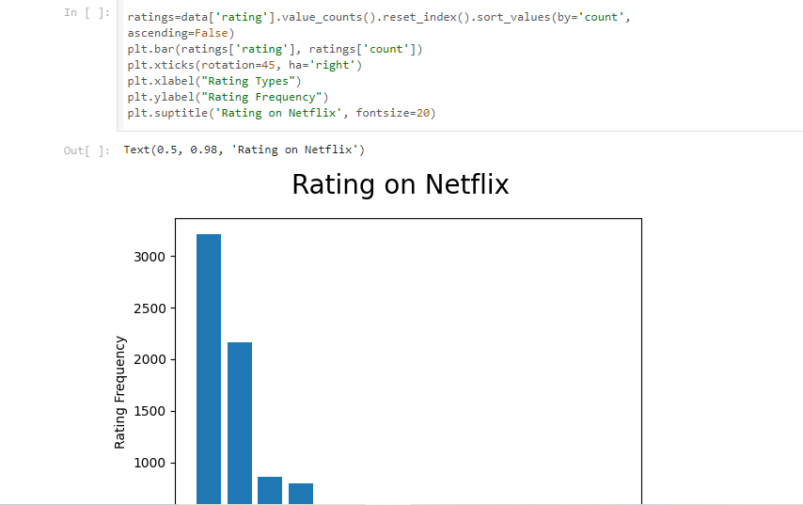

Slide 13
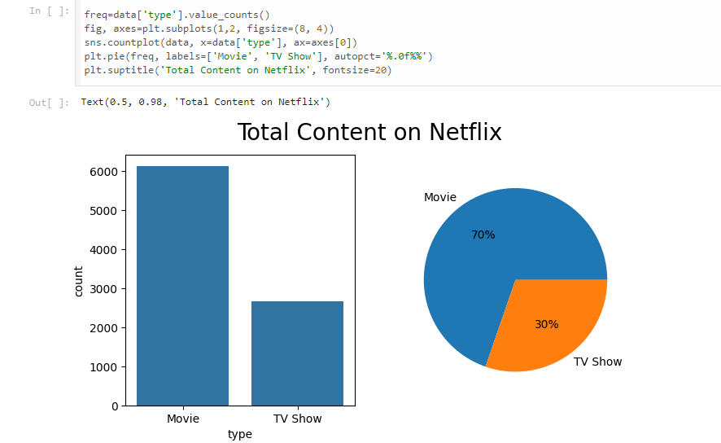

Slide 14
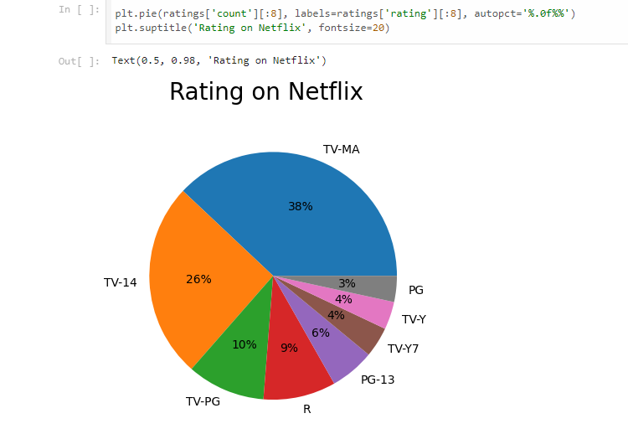

Slide 15
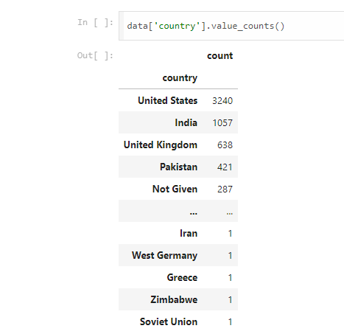
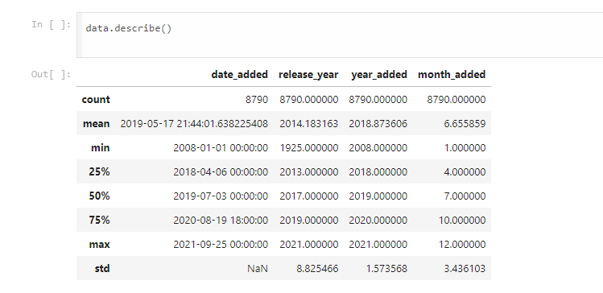

Slide 16
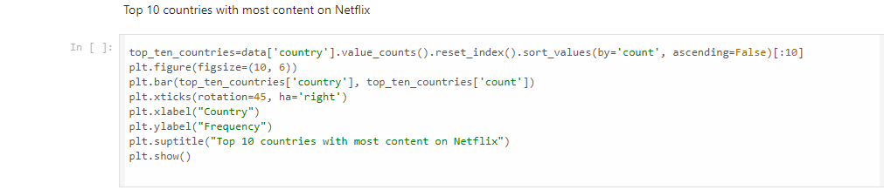
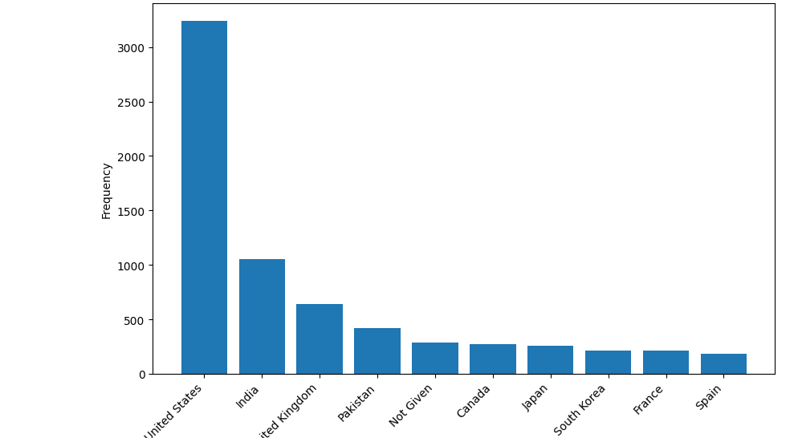

Slide 17
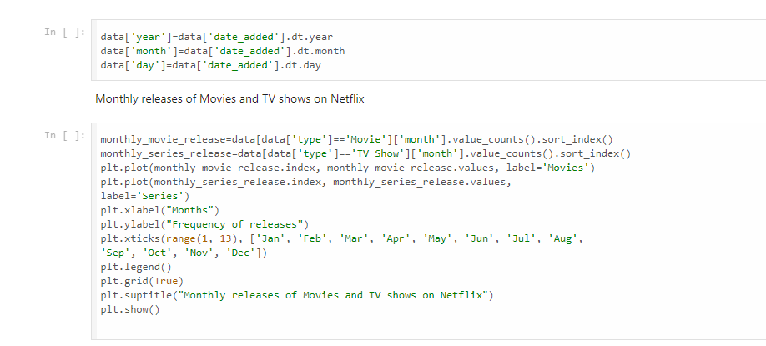
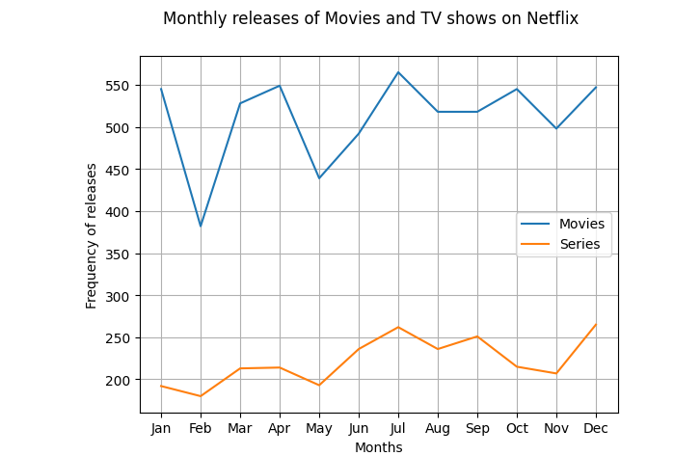

Slide 18
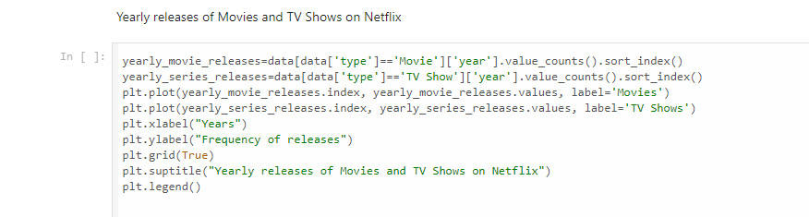
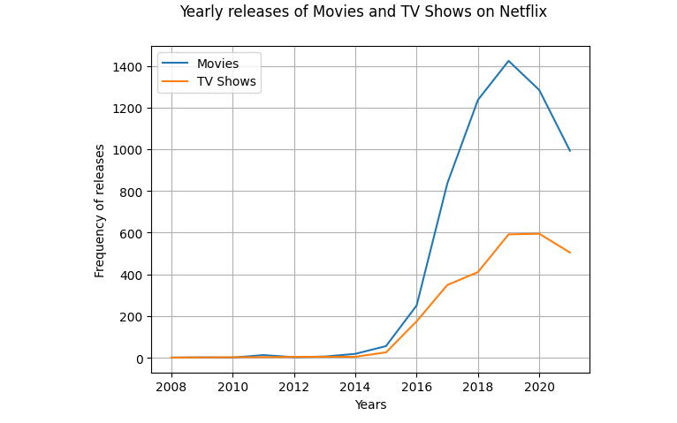

Slide 19
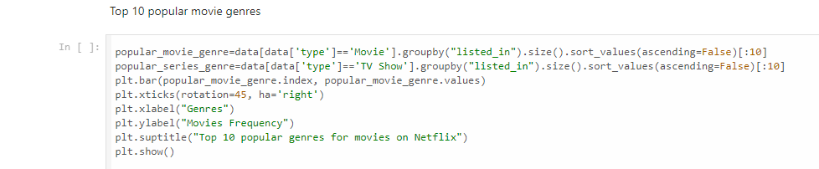
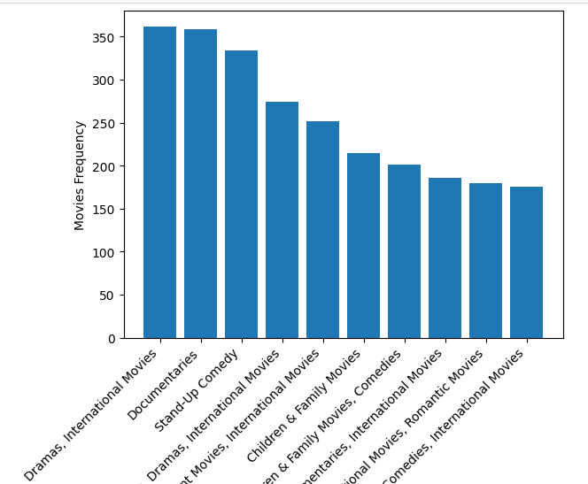

Slide 20
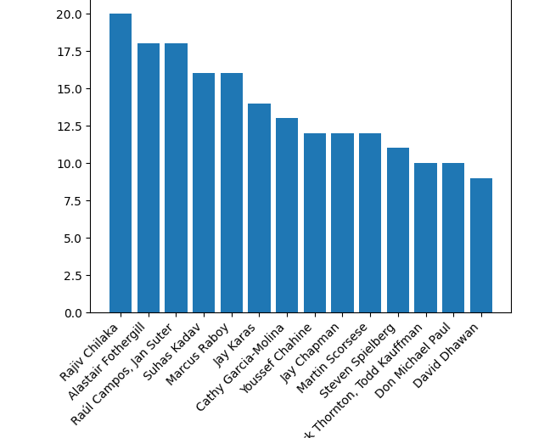
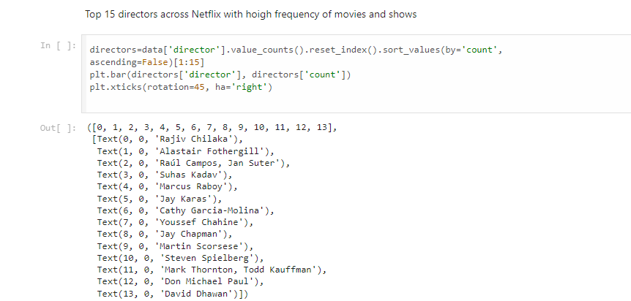

Slide 21
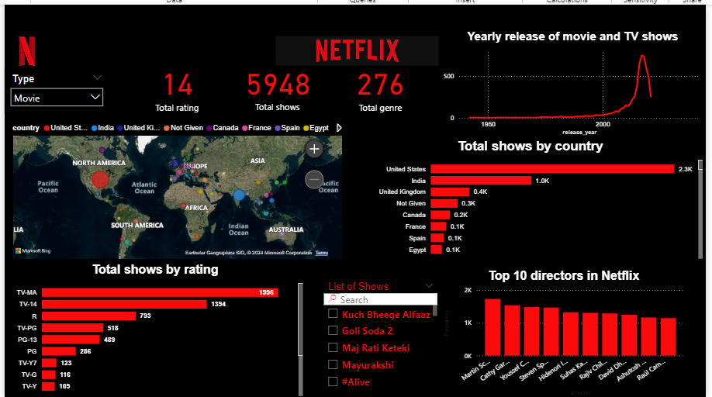
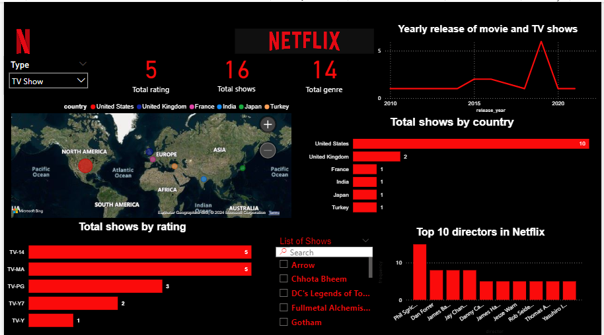
DATA VISUALISATION USING POWER BI

Slide 22
CONCLUSION:-
MOVIES
Content Breakdown by Type (Movies)
Total Ratings: 14 different ratings are shown, highlighting the range of content available on Netflix.
Total Shows: 5,948 shows are displayed, indicating a large library of content categorized under the selected type (movie).
Total Genres: 276 genres are represented, showcasing the wide variety of genres available on Netflix.
Geographical Distribution of Content:
The map visualizes the distribution of Netflix content by country. The largest bubbles appear over the United States and India, implying these countries have the most content on Netflix.
Yearly Release of Movies and TV Shows:
There is a spike in content releases post-2000, with a significant peak in recent years. This suggests a growing trend in Netflix's production or acquisition of new content, especially in the digital streaming era.
Total Shows by Country:
The United States dominates with 2.3k shows, followed by India with 1.0k. Other countries like the United Kingdom, Canada, and Spain also contribute, but to a lesser extent.

Slide 23
Total Shows by Rating:
TV-MA (Mature Audience) is the most prevalent rating with 1,996 shows, followed by TV-14 with 1,394 shows.
There’s a significant number of content rated R (793), TV-PG (518), and PG (286), indicating a balance between content for mature audiences and family-friendly options.
Top 10 Directors in Netflix:
The top directors on Netflix include familiar names, with the top director having over 1.5k shows attributed to them. This indicates the strong influence and popularity of certain directors in the platform’s content library.
List of Shows:
A section of the dashboard allows users to search for specific shows.

Slide 24
Key Insights:
Content Variety: Netflix offers a wide range of content ratings, genres, and productions from different countries, with a significant focus on mature and teen audiences.
Regional Dominance: The United States and India are the two largest contributors to Netflix's content library, likely reflecting both production and consumption trends in these countries.
Director Impact: A few directors have a substantial amount of content, highlighting key figures who are central to Netflix's content strategy.
Content Growth: There is a clear trend of Netflix expanding its content offerings dramatically after the 2000s, possibly driven by the rise of digital streaming platforms.
This dashboard provides a broad understanding of Netflix’s content library distribution, both geographically and by type, along with trends in ratings, genre diversity, and the contribution of top directors.

Slide 25
TV SHOWS
Total Number of TV Shows, Ratings, and Genres:
There are 5 TV shows listed in the dataset.
These shows cover 16 total ratings and 14 different genres, indicating a diversity of content available.
Yearly Release of Movies and TV Shows:
The graph suggests a spike in TV show releases around 2020. Prior to this, there is steady growth, indicating that Netflix had a significant boost in content releases during this period.
Total Shows by Country:
United States dominates with 10 shows.
The United Kingdom follows with 2 shows, while France, India, Japan, and Turkey have 1 show each.
This breakdown reflects Netflix's focus on US-based content while also showcasing some international diversity.
Total Shows by Rating:
The content distribution based on ratings is as follows:
TV-MA (Mature audiences): 5 shows.
TV-PG: 3 shows.
TV-Y7: 2 shows.
TV-Y: 1 show.
This indicates a skew towards more mature content, with a good variety for younger audiences as well.

Slide 26
5. Top 10 Directors in Netflix:
Phil Sgriccia stands out with the highest number of shows, followed by other directors like Dan Forester and Jared B.
This suggests that Netflix might have repeat collaborations with certain directors for TV show production.
6. Geographic Distribution of Shows:
The map visual indicates a global presence of shows with the majority concentrated in North America (United States) and some representation across Europe, Asia, and Turkey.
7. List of Shows:
The available list includes shows like Arrow, Chhota Bheem, DC's Legends of Tomorrow, and others. The selection seems to include both international and genre-diverse options.

Slide 27
Insights:
Content Distribution: Netflix seems to emphasize US-based TV shows with a majority of mature-rated content. There is some effort to diversify geographically with shows from the UK, France, India, Japan, and Turkey.
Release Trends: The spike in releases in 2020 could be related to a variety of factors, including the increased consumption of content during the global pandemic.
Director Influence: A handful of directors dominate the production of Netflix's TV shows, suggesting possible partnerships that are driving the platform's content production strategy.

Slide 28
THANK YOU

